Slide 1

EMPLOYEE
ATTRITION
E-NUMPY (BATCH 19A)

Slide 2





THE TEAMS
Ilham Taufiqurrohim
M Chosasih Mahendra
Putri Maylita
Rama Kuswidyawan
Samuel Akwila

Slide 3
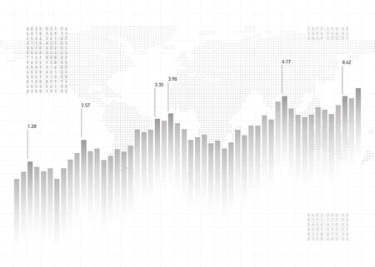
OUTLINE
Project Intro
Methods
Result & Recommendations
4
7
19

Slide 4

PROJECT
INTRO

Slide 5
PROJECT DESCRIPTION
Background, Context and Problem.
In one year, the number of employees of Kagg Company decreased from 1470 → 1233 (reduced by 237 or 16%)
The SHRM Human Capital Benchmarking report found that the average employee turnover rate in 2017 was 18%, and less than 50% of organizations have a succession plan. Organizations should target 10% for employee attrition.
Marc Prosser (CEO and co-founder of Choosing Therapy), said that, if the employee turnover rate is more than 15% per year, the company has a high employee turnover rate.
Therefore, the problems that this project will solve are:
1. What are the factors that drive employees to attrite?
2. What steps can be taken to prevent employees from attrition?

Slide 6
PROJECT DESCRIPTION
Goals
Finding the factors behind employees to attrice from the data provided using predictive modeling.
Provide recommendations to prevent employees from attrition.
Objectives
Business Metrics
Employee Attrition Rate

Slide 7
METHODS

Slide 8

DATA COLLECTION
Employee Attrition
.csv
1470 Rows
35 Columns

Slide 9
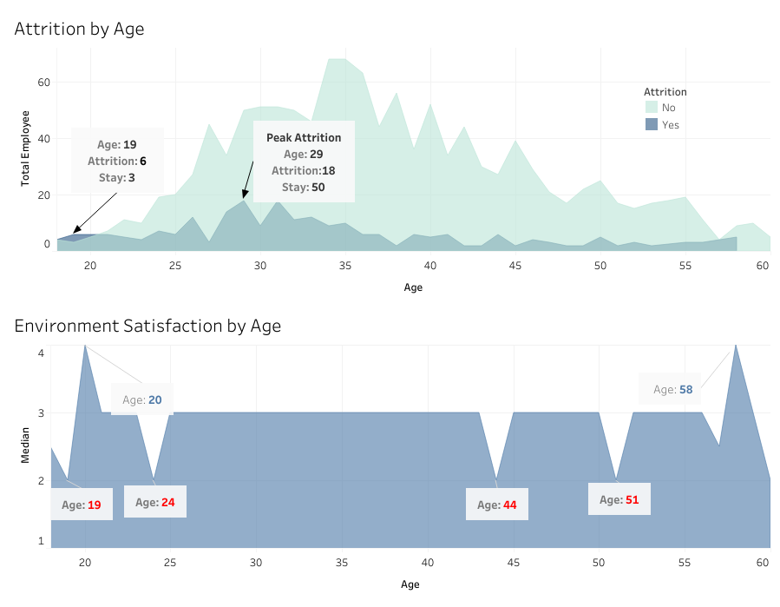
EXPLORATORY DATA ANALYSIS
The number of attrition employees at the age of 19 years is more than those who stayed.
The level of environmental satisfaction at the age of 19 years is low.
At the age of 20 years showed a high rate of environment satisfaction.
Perceptions of environmental satisfaction seem to fluctuate in the young age range (18-25 years).

Slide 10
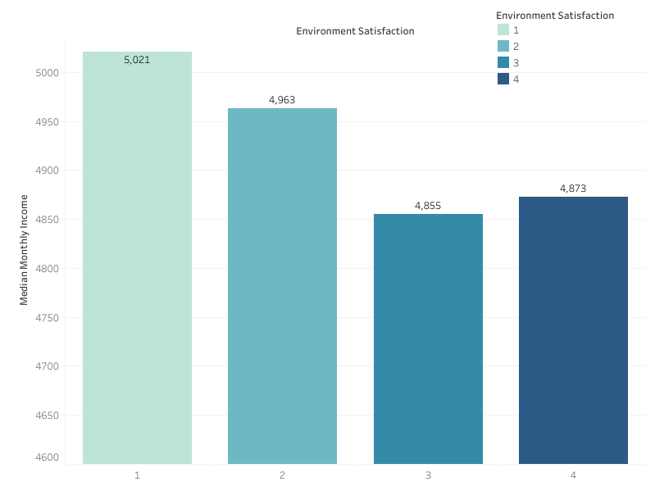
EXPLORATORY DATA ANALYSIS
Environment Satisfaction by Monthly Income
The lower the median monthly salary, the higher the satisfaction with the work environment.
The median monthly salary difference between perceptions of job satisfaction is approximately $100.
The higher the salary does not guarantee that employees will be more satisfied with the company environment.

Slide 11
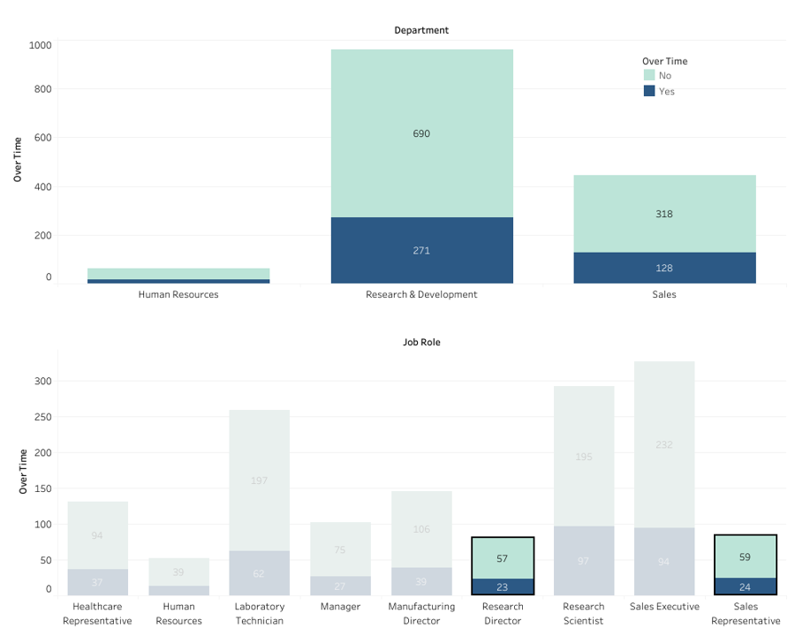
EXPLORATORY DATA ANALYSIS
Over Time by Department, Job Role
Sales and R&D departments have the highest percentage of Overtime, especially Sales Representatives and Research Directors.
The Human Resource Department very rarely gets Overtime.

Slide 12
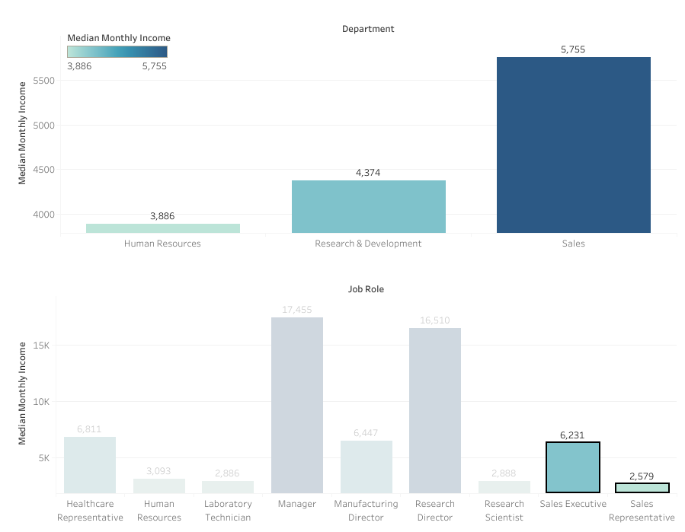
EXPLORATORY DATA ANALYSIS
Monthly Income by Department, Job Role
The Sales Department has the highest median monthly salary.
There is a significant gap in the Sales Department.

Slide 13
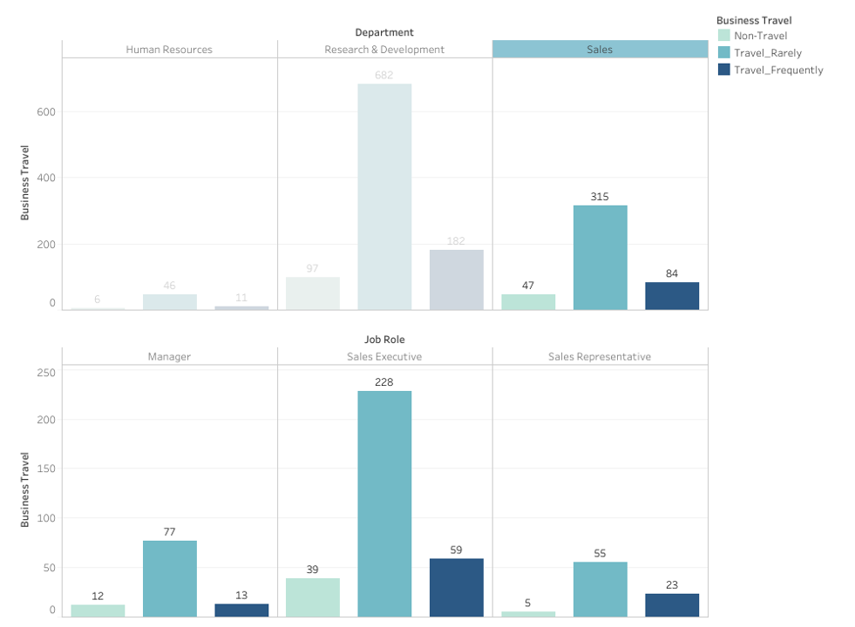
EXPLORATORY DATA ANALYSIS
Business Travel by Department, Job Role
The Human Resources Department rarely gets Business Travel opportunities.
The R&D department quite often gets Business Travel opportunities.
The Sales Department in the Sales Representative Job Role is a very mobile position.

Slide 14
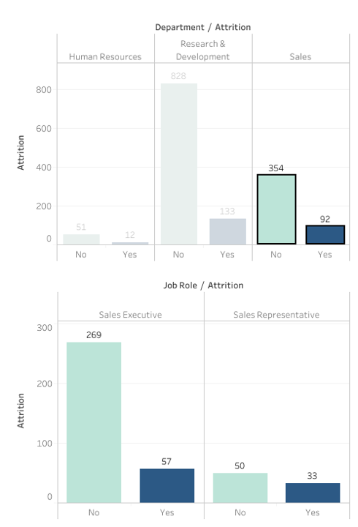
EXPLORATORY DATA ANALYSIS
Attrition by Department, Job Role
The Sales Department needs attention because it often gets Over time, there is a large salary gap and is very mobile.
The highest percentage of attrition occurs in the Sales Department with a Job Role Sales Representative.

Slide 15

DATA PREPROCESSING
Handle Irrelevant Value
Handle Outlier
Feature Engineer
Delete features:
EmployeeCount
StandardHours
Over18
EmployeeNumber
Outliers are removed using Z score > 2.
Feature Encoding
Label Encoding : Attrition, OverTime, Gender, Business Travel
Feature Selection:
Removes redundant features and removes features with low correlation to Attrition

Slide 16
DATA PREPROCESSING
Feature Transformation
Modeling
Evaluasi
Log Transform Feature:
MonthlyIncome
TotalWorkingYears
YearsAtCompany
2. Normalisasi
Normalize numerical data using StandardScaler.
Using Logistic Regression algorithm with Random Oversampling.
Metrics used Recall and ROC-AUC.
Evaluate the model and Feature Importance.

Slide 17
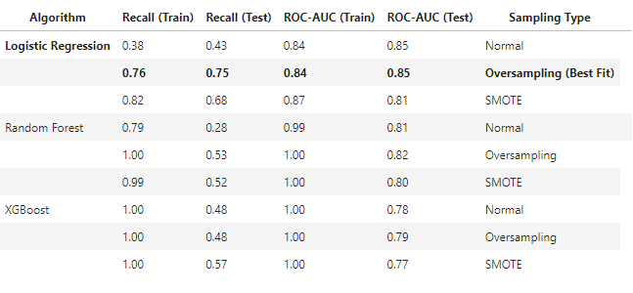
PREDICTIVE MODELING
Machine Learning
Random Oversampling, SMOTE
The method in converting the minority sample into as many as the majority sample.
Tuning Hyperparameter
Metric 1 : Recall
Metric 2 : ROC - AUC

Slide 18
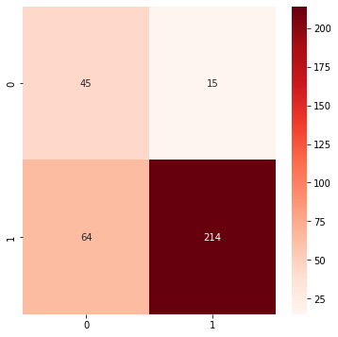
PREDICTIVE MODELING
Confusion Matrix
Focusing on predictive models that are best at reducing false negatives.
True Positive
False Negative
False Negative: Prediction results of employees staying in the company but in fact employees leave the company,
False Positive
True Negative
Notes:
minta dirapihkan

Slide 19
RESULTS &
RECOMMENDATIONS

Slide 20
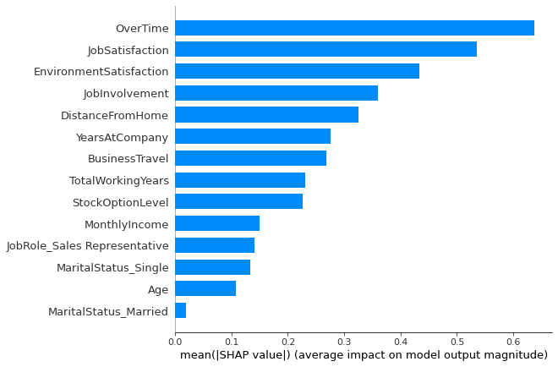
RESULT
Features Importance with SHAP Value
Top 3 Global Feature Importance
Over time
Job Satisfaction
Environment Satisfaction
Sales Representative is the only job role that affects attrition

Slide 21
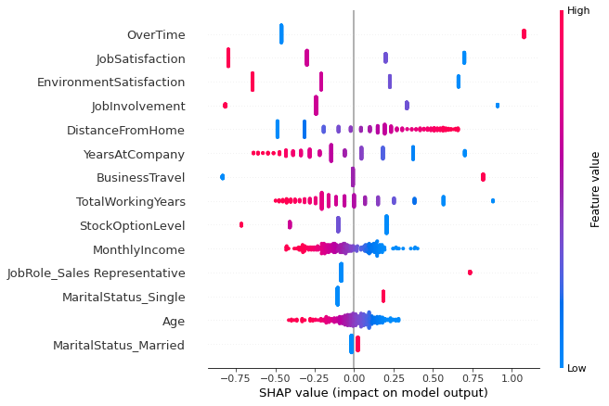
RESULT
Features Importance with SHAP Value
Top 3 features drive positive to attrition:
Over time
Distance From Home
Business Travel
Top 3 features drive negative to attrition:
Job Satisfaction
Environment Satisfaction
Job Involvement

Slide 22
SIMULATION
Manipulate 50% Attrition Employee Data
Overtime = Yes
Overtime = No
237
(16%)
133
(9%)
Notes:
kurang spesifik dan kurang banyak

Slide 23
RECOMMENDATION
Since Overtime has a high impact on Employee Attrition, companies should focus on changing the company's Overtime structure.
Evaluate the cause of Overtime
Seeing the root of the problem is the most important thing. The HR team can retrieve data from employees who often get Overtime to see the main Overtime problems. Things like excessive workload, unclear job descriptions, and lack of team communication can be major factors.
Making Overtime Policy
Implement standard Overtime limits for each employee and provide monthly/quarterly/annual compensation according to the number of Overtime hours of the employee.
Can take leave the next day or get compensation directly if in one day the Overtime exceeds the daily standard limit.
Conducting a Cross-Training program
Providing additional training outside the field can be a solution for companies to make employee skills even, thereby reducing the accumulation of work by several employees due to the lack of experts.
Work Efficiency
Conduct further studies on jobs that often get Overtime such as Sales Representative, regarding the utility of resources whether sufficient or require additional resources.

Slide 24
Thank You

